Slide 1
Business Is Great!
High School Business Idea Competition
To promote entrepreneurship, spur creative thinking, and encourage students to start a business.

Slide 2
What’s Inside?
BIG Idea Overview & Prizes
Getting Started
BIG Idea Entry Outline & Resources
Final Competition Outline & Resources

Slide 3
BIG Idea Overview & Awards

Slide 4
Where to begin?
BIG Idea Competition
“Every idea needs a chance to grow”
Hands on entrepreneurship introduction
Great springboard for other competitions
An idea for a business that would serve a local area or an idea for a new / innovative product or service
Marketing Design Competition
Optional
Allows students to create a marketing piece to support proposed business idea
Make sure to include all business information (name, location, contact, etc.)
www.bigideasd.com
Notes:
Add link for Rules and How To video; update home page screen shot

Slide 5
Where to begin?
BIG Idea Competition
Special Student Awards
Wellness
Food Animal Agriculture
Marketing Design
Teacher/School Awards
FREE Makerspace Consultation from CREATE
Partners in Business Award
www.bigideasd.com
Notes:
Update home page screen show; add description

Slide 6
Resources
BIG Idea Rules found on the Rules Page
10th Anniversary Video
BIG Idea How To Videos on the YouTube Channel
Marketing Design Guidelines

Slide 7
Getting Started

Slide 8
Where to begin?
Teachers/Advisors Getting Started
Go to www.BIGideaSD.com
Click on Advisor Login
Login in or create your account after Sept. 1st and before your student(s) create account
If you remember your login information, just login in
If you are new, you will need to create an advisor account

Slide 9
Teacher Dashboard
Login to access to your dashboard where you can:
Track students who have selected you as an advisor.
Review student entries & marketing designs
Track submission status
Access teacher resources

Slide 10
Students’ Checklist to Begin
When students first login their need to complete the BIG Idea Entry Form before continuing.
Create your UNIQUE login
Only 1 profile is needed per team
Enter primary login email
Choose password
Do not forget your login information
Enter Profile Information
School
Advisor
Your Name
Address
Phone
Enter Business Name and Team Information
Complete BIG Idea Entry Form

Slide 11
Industry Classification
New this year!
Students will be asked to classify which industry their business idea belongs to.
Based on the 16 career clusters, the industry dropdown list includes:
Agriculture, Food & Natural Resources
Architecture & Construction
Arts, A/V Technology & Communications
Business Management & Administration
Education & Training
Finance
Government & Public Administration
Health Sciences
Hospitality & Tourism
Human Services
Information Technology
Law, Public Safety, Corrections & Security
Manufacturing
Marketing
Science, Technology, Engineering & Mathematics
Transportation, Distribution & Logistics
Drop down arrow
Notes:
Should provide a screen shot of it from the back end

Slide 12
Resources
Career Clusters Industry Classifications

Slide 13
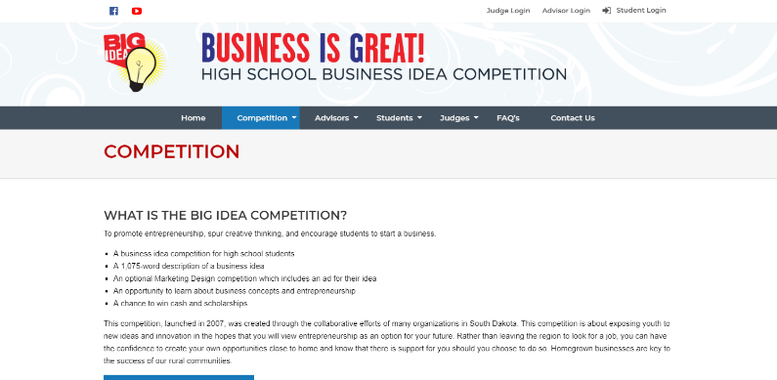
Getting Started Tips
Get Started
Use Word to create
Copy / paste into website
Use as a classroom activity (every Friday, 10 minute warm-up, etc.)
Correct sentence structure
Professional language
Answer every question!
Do not use the “I”, use business language instead
Use the entire amount allowed for words
Use the EXAMPLES to guide students
Notes:
Update screen shot,
Update/create login after Sept 1 but before students do
Resources:
teacher resources
Need help with thinking of Business Ideas…. Link to Dr. Hart info
How to Tips for Success

Slide 14
Resources
Teacher Resources
Need help with business idea?
How To: Tips for Success
Starting Your Business Resources

Slide 15
BIG Idea Entry Outline & Resources

Slide 16
Student Profile
Students will start by creating a login account and adding profile data including:
Student Contact Info
School and Advisor
Business Name
Eligibility for Special Awards
Industry Classification
Other Team Members (if applicable)

Slide 17
Concept Overview
Concept Overview (75 words)
Summary of the idea
Correct sentence structure
Questions:
What is your business idea?
What is the problem you are trying to solve or need you are satisfying, and for whom?

Slide 18
Concept Overview
EXAMPLE:
Prairie Hill Lawn Care will serve the newly developed Prairie Hill neighborhood where homeowners want to have a nice lawn but may not have the time or equipment to care for the lawn themselves. In this upscale development, our customers are homeowners who can afford lawn care services.
Word Count: 49
Did you include / Use the Rubric:
Who
What
Where
When
Why
For whom?
What can be added:
What need is being met?
Target market?
Socioeconomic class / gender?
First mover advantage?
Notes:
Add list of Resources for this section:
How To video
Others?

Slide 19
Resources
How To: Concept Overview
Elevator Pitches

Slide 20
Product or Service
Product or Service (250 words)
Describe what your business sells
Questions:
What is the product or service?
How will the product be produced or the service performed?
What are the features and benefits of the product or service and its potential drawbacks?
What are the unique aspects of your product or service?

Slide 21
Product or Service
EXAMPLE
Prairie Hill Lawn Care will offer lawn care services to the Prairie hill neighborhood by providing quality service at an affordable price. Prairie Hill resident take great pride in their new homes and are interested in having a good looking, well-kept yard. The services will include cutting the lawn, trimming the edges and bagging the cuttings. Currently, there is not a contracted lawn care provider in this development. That is why our business will be the first mover into this location. No other landscaping services will be provided by this business at this time. We seek to target busy professionals with careers and families as well as renters and owners who do not have lawn care equipment or do not care for their yard themselves. It is estimated that a lawn cutting service is needed mid-April through the end of October for a total of 26 weeks of service but is subject to change depending on weather conditions. It is estimated that the average lawn will need cutting twice a week during the peak season of June – August and once a week during other times, again, subject to weather conditions. I will provide the services myself as owner and seek to develop a relationship with customers by gather specific information from them about their lawn care needs.
Word Count: 218

Slide 22
What can be added: Be SPECIFIC – assume the reader does not know your product Future goals Staff / employees that will provide products / services Potential drawbacks - include inexperience of owner Cost effective Cost of product / service Cost of employees / staff Cost of goods sold Package options Breakeven point! Judges love this part!
Product or Service
Notes:
Resources:
How to video,
link to sections on resources page

Slide 23
Resources
How To: Product or Service

Slide 24
Market Opportunity
Market Opportunity (250 words)
Who will you sell to?
What is the market size (local, national, international)
Questions:
Describe your industry – size, trends, growth, etc. (industry examples include retail, service, construction, agriculture, etc.)
Describe the characteristics of your customers (location, age, race, income, lifestyle, etc.)
What factors will impact how you price your product or service?
How will you promote your product or service

Slide 25
Market Opportunity
EXAMPLE
There are currently an estimated 654 households in the Prairie hill neighborhood of Prairietown (based on census data for the zip code). It is estimated that over 50% of the households have lawns and therefore might have a need for my service. It is estimated that the average household spends $100 per year on lawn care services, which would indicate a total market of $65,400 in the Prairie Hill neighborhood. The neighborhood has a median income of $58,664 with 84% consisting of households with children where both parents are working. This segment of the population and income demographic is growing and would likely have the ability to pay someone to take care of their lawn. Starting out as a one-person business, I am hoping to gain 15 – 20 regular customers by the end of the first year, which is a small percentage of the total neighborhood market. I will promote my business through local newspapers and flyers to individual homes. As I gain customers, I will provide incentives to my customers to refer my services to their neighbors. I estimate that I will be charging in the area of $20 hour for my services. Jobs can be priced by the hour or by the job. Word Count: 206

Slide 26
What can be added: 4P’s of marketing & describe how each will be met (product, place, price, & promotion) Target market (who is your best customer) What geographic area do you serve? Incentives? Online/social media plan? Put numbers / analytics! Judges love this part!
Market Opportunity
Notes:
Add Resources:
How To videos
Links to Section of Resources page
Census.gov

Slide 27
Resources
How To: Market Opportunity
Marketing Resources

Slide 28
Competition
Competition (250 words):
What other options do your customers have
Questions:
Who are your competitors?
What is unique about your product or service? How does it differ from the competition?
Compare & contrast the strengths / weaknesses of your business and your competitors.
How easily can others compete with you?

Slide 29
Competition
EXAMPLE
While there are 14 lawn care businesses in the county, there are no established lawn care services within the Prairie Hill neighborhood since the area if fairly new. I plan to differentiate my business from other services by my close proximity to my customers and by offering a reliable, efficient and affordable service that is personalized to fit each customer’s needs. Competitors are primarily full-service, large-landscaping and lawn care businesses located five miles or more from the neighborhood. These competitors are well-established businesses with an existing client base, and therefore have less capacity to serve new clients, particularly in an area some distance from their location. Services provided by the competition include not only lawn mowing services but also landscaping and weed spraying services. Their average charge is $30 to $40 per hour. At closer to $20 per hour, Prairie Hill Lawn Care will be an attractive alternative for new homeowners who want a nice looking yard but have other demands on their disposable income with new homes and families. The charge for a typical residential yard is estimated at $15 - $20 for a basic cut. New customers will be interviewed to gather pertinent information about their yard maintenance needs (times of service, obstacles or specific features in the yard, any special events, etc.). Customers will also be confident knowing the person gathering this information will also be cutting their lawn each time. Possible weaknesses of the business are the inexperience of the business owner and limited services.
Word Count: 250

Slide 30
What can be added: Competitive advantage – what is unique Reliability of the business vs. competition Efficiency of the business vs. competition Cost effective vs. competition What % of the market will the business obtain How will it increase sales vs. the competition Remember that there are always competitors! (What other choices do your customers have? How are they currently meeting their need.)
Competition
Notes:
Add Resrouces section… video, links

Slide 31
Resources
How To: Competition

Slide 32
Management & Operation
Management & Operation (250 words):
What people, equipment or technology will be needed to operate your business?
Questions:
Identify the key persons and skills needed to implement your idea.
What physical facilities or technology are needed to produce or deliver the product or service?
Once established, what will be your biggest expense month-to-month? Please explain.

Slide 33
Management & Operation
EXAMPLE
I will provide the labor for services as well as management and promotion of the business with no employees for at least the first year. I could manage 15 – 20 customers based on an average of 1 hour per yard two times a week during the peak season. As I acquire more than 20 customers, a second employee will need to be considered in order to help run an efficient business. Gathering customer data and yard specific information will require me to meet with the customers and learn what the customer wants done with their lawn so that we can satisfy their needs. Customers will be quoted a price for their lawn services, and payment will be expected at the time of service in order for smooth business operations. Bookkeeping will be completed during off peak hours. The equipment needed for the business consists of riding and push lawn mowers, a trimmer, rakes, bags for the cuttings and a gas can. The necessary vehicle and trailer will be stored in my father’s garage at no cost to the business. Other expenses would be printing of flyers, fuel for equipment and vehicles, insurance, cell phone, licensing of the vehicle and trailer, and bookkeeping materials.
Word Count: 204

Slide 34
What can be added: Staffing – roles, training/skills required Hours / days of operation Peak season vs. off season Opportunity for growth Exit strategy Social responsibility (Going GREEN, etc.) Strategic goals
Management & Operation
Notes:
Add Resources section – video, links

Slide 35
Resources
How To: Management & Operations

Slide 36
Before submitting …
READ through document for any grammatical or spelling errors
CHECK for plagiarism

Slide 37
Final Competition Outline & Resources

Slide 38
Who are the Finalists?
A judging process in early November determines the top 8 scoring entries as finalists.
Finalists compete with a verbal presentation at the Final Competition.
Additional judging will determine one winner in each category of Marketing Design, Wellness and Food Animal Agriculture.
Category winners will be recognized at the Final Competition.

Slide 39
Final Event Activities
Morning Activities
Finalists connect with mentors
Presentations to Judges
Cobot Demos
Photo Opportunities/Table Games
Afternoon Activities
Lunch
Elevator Pitches to audience
Keynote Speaker
Business Entrepreneurship Panel
Awards Ceremony
Afternoon activities are livestreamed for those that cannot attend
Anyone can attend and participate in these final event activities

Slide 40
Presenting at BIG Idea
Different judges than first round - be prepared!
These judges have not judged the actual BIG Idea but are provided a copy prior to the final event
6 minute presentation (includes Elevator Pitch)
Start with Elevator Pitch and then launch directly into full presentation
Be sure to include financial information
Use visual aid (at least 1 is required)
Follow the rubric
Do not read off slideshow
Do not use note cards
Use Mentors to help anticipate questions to be asked
Check out elevator pitches and past winners presentations
Notes:
Resrocues:
Video, links, pitches and past winners

Slide 41
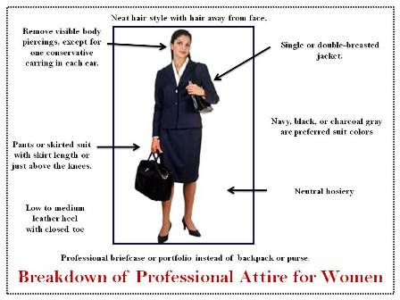
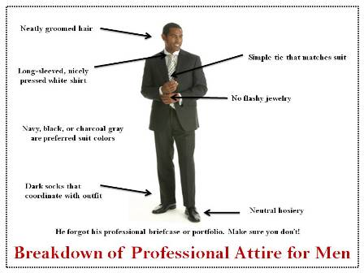
Presenting Big idea
Dress professional!
Dress for your business!

Slide 42
Resources
Elevator Pitches and Student Presentation Found on our website on the Past Winners Page or the BIG Idea YouTube Channel
Start Up Costs Worksheet
Business Expense Worksheet
Presentation Tips

Slide 43
Mentorship Program
The top 8 finalist teams will be paired with a BIG Idea Mentor.
BIG Idea Mentors are a BIG deal!
The mentor will reach out to teachers and finalists prior to the Final Competition.
BIG Idea Mentors will provide students with knowledge, wisdom, experience, and insight about:
Your Business Idea
Unanticipated Questions (from judges at final event)
Building Your Network
Presentation Skills
Making Your Idea a Reality
Career Paths
Notes:
Should we add mentors at final event after slide 31
Created different slides for these different topics

Slide 44
Teacher Awards
Partners in Business Award
Mentorship is a huge part in starting and running a business
We are adding the Partners In Business Award to encourage teachers and students to expand their network.
Watch for more details in upcoming emails!
Makerspace Consultation Prize
Every teacher can sign up
Receive a free consultation for exploring the possibility of a makerspace in your community or school.
A Makerspace is a place where students and community members have access various tools and resources for them to create and explore new ideas.
Apply by emailing your school name and contact person (name,phone,email) to Kelly Weaver at kelly@growsd.org
Winners of both the Partners in Business Award and the Makerspace Award will be announced at the Final Competition, Wednesday, December 5, 2018.

Slide 45
Can’t Make the Final Event?
PARTICIPATE ONLINE
via livestream option!
See elevator pitches from the finalists!
Learn from business speakers!
Notes:
Include link to livestream,

Slide 46
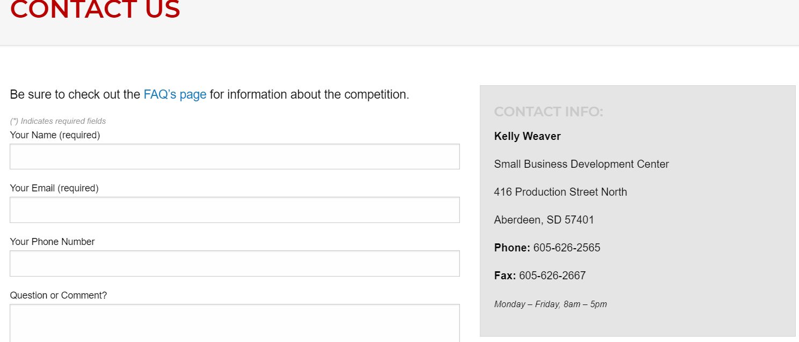
Questions? Contact us!
We are happy to answer questions about the program, getting started, student or advisor accounts, the application, the final event, etc. The only silly question is the one that is not asked!
www.bigideasd.com

